Slide 1

WATERFALL METHODOLOGY
23.4.21

Slide 2

Agenda
TRADITIONAL PROCESS MODELS
HISTORY
WHAT IS WATERFALL?
SDLC OF WATERFALL MODEL
WHEN IS WATERFALL USED?
ADVANTAGES AND DISADVANTAGES
EXAMPLES
WATERFALL VS AGILE

Slide 3
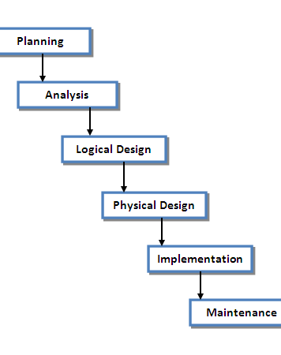
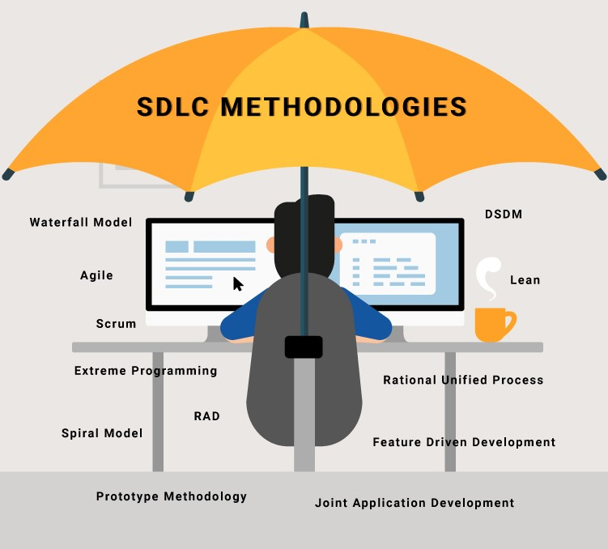
INTRODUCTION
TRADITIONAL PROCESS MODELS
Waterfall model-The process is strictly sequential.
Prototyping model- reduce risk by building a quick replica or mockup of the intended system
Spiral model- Follows an evolutionary approach

Slide 4

THE WATERFALL METHODOLOGY
Let’s Dive In

Slide 5
What is Waterfall?
The Waterfall Model was the first Process Model to be introduced.
It is also referred to as a linear-sequential life cycle model.
It is very simple to understand and use.

Slide 6
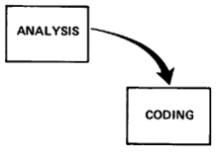
History of waterfall
This model was 1st introduced by Dr. Winston W. Royce in a paper published in 1970. It is a software development process. The waterfall method emphasizes on logical steps to be taken during using waterfall implementation.

Slide 7

When is the waterfall methodology used?
Facts about SDLC WATERFALL
Used for embedded systems (by Sommerville)
Stable Requirements, not changed frequently and should be well understood(hardware used systems )
Less Customer involvement
It is plan driven model used when risk is high like a risk of life e.g insulin pump delivery system..

Slide 8
Sdlc of waterfall model
Directly
Reflects
the Fundamental Development Activities
Communication
Project initiation
Requirements gathering
Planning
Estimating
Scheduling
Tracking
Modeling
Analysis
Design
Construction
Code
Test
Deployment
Delivery
Support
Feedback
Software development life cycle

Slide 9
PHASE | ACTIVITIES
COMMUNICATION | Inception , elicitation , negotiation ,specification , validation. (Consider all the requirements then Brainstorm them Do the requirement feasibility test to ensure that the requirements are testable or not).
PLANING | Identify task and their sequence , assign resources, calculate milestone, scheduling task ,cost estimation, time identification.
System modelling | Analysis of requirements Design the solution
CONSTRUCTION Coding b. System testing | Now based on the design create the code. Fit in the codes for the next phase Test the code to make sure it works exactly as its supposed to.

Slide 10


Continuation…
PHASE | ACTIVITIES
SYSTEM DEPLOYMENT | (deliver the solution and take feedback)
SYSTEM MAINTENECE | Make sure that the application is up and running in the respective environment

Slide 11
Advantages and disadvantages
Of the waterfall methodology

Slide 12
Advantages of
WATERFALL METHODOLOGY
Simple and easy - Simple and easy to understand and use.
Beneficial for smaller projects- For smaller projects, the waterfall model works well and yield the appropriate results.
Sequential- Since the phases are rigid and precise, one phase is done one at a time, it is easy to maintain
Shows progress- Waterfall project management also shows progress simply. The clear milestones described in the first phase make it easy to determine if a project is moving forward on schedule.
Single order- The entry and exit criteria are well defined, so it easy and systematic to proceed with quality.
Documented without iterations- Results are well documented.
Easy managing- The linear nature of the system, make waterfall projects easy to manage.
Early design- Allows early design changes

Slide 13
Disadvantages OF
WATERFALL METHODOLOGY
Cannot adopt the changes in requirements
It becomes very difficult to move back to the phase.
For example, if the application has now moved to the testing stage and there is a change in requirement, it becomes difficult to go back and change it, It is impossible.
Delivery of the final product is late as there is no prototype which is demonstrated.
For bigger and complex projects, this model is not good as a risk factor is higher.
Not suitable for the projects where requirements are changed frequently.
Does not work for long and ongoing projects.
Since the testing is done at a later stage, it does not allow identifying the challenges and risks in the earlier phase so the risk assessment is difficult.

Slide 14
EFFECTIVE AND INEFFECTIVE PROJECT CHOICES
Of the waterfall methodology

Slide 15






Effective project choices
WATERFALL METHODOLOGY
Frozen Requirements
Mission Critical Projects
Embedded Systems
External Projects Involved(hardware Related)
Defense Department
Military and Aircraft Forces
Space Shuttles
WELL-UNDERSTOOD PROBLEMS
Construction
Nuclear materials
Embedded Systems
.

Slide 16



In-Effective project choices
WATERFALL METHODOLOGY
Games
Web based
Stock Trading
You can afford to handle
Changing requirements
Customer involvement

Slide 17
WATERFALL VS OTHERS
WATERFALL METHODOLOGY
WATERFALL | INCREMENTAL | AGILE | SPIRAL
Plan Based | less planning | less plan keep it simple | detail plan
Traditional | Traditional | modern approach | evolutionary
Less Client involvement | high client involvement | high client involvement | involvement minimal
Very costly while Changing in requirement | accept changes so does not change frequently | easy adaptation | Expensive to change

Slide 18
.
COURSE : Software Development
SUPERVISOR : Prof. Farzeen Ashfaq
TEAM MEMBERS
B19103067
WAIZA WAQAR
B19103047
NEHA HAROON
B19103024
MAHEEN ABDUL WAHID
B19103051
RUTABA IMRAN
.

Slide 19
Thank You!
.

